Slide 1
Computer architecture and Organization Processing Unit
M. Khademul Islam, PhD Professor, Dept. of CSE, Rajshahi University, Bangladesh Email: khademul.cse@ru.ac.bd, tel: +88-01727-786600 web: www.ru.ac.bd/cse/~mki

Slide 2
Processing Unit
The central processing unit (CPU) of a computer is the main unit that dictates the rest of the computer organization
Register set: Stores intermediate data during the execution of instructions;
Arithmetic logic unit (ALU): Performs the required micro-operations for executing the instructions;
Control unit: supervises the transfer of information among the registers and instructs the ALU as to which operation to perform by generating control signals.

Slide 3
Processing Unit
Functions of CPU
Central Processing Unit = “brain of computer”
Executes programs by:
Fetching and decoding the next instruction from memory
Execute it
Consists of:
Control Unit
Arithmetic Logic Unit (ALU)
Registers (high-speed memory)
Program Counter (PC)
Instruction Register (IR)

Slide 4
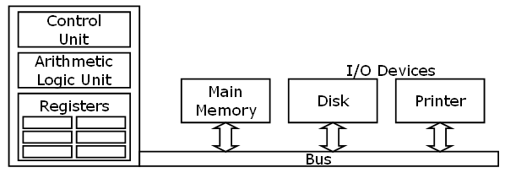
Processing Unit
Functions of CPU
BUS connection with CPU

Slide 5
Processing Unit
General register organization
CPU must have some working space (fast access and close to CPU)
This space is efficiently used to store intermediate values
The most convenient way to communicate registers is trough common bus system

Slide 6
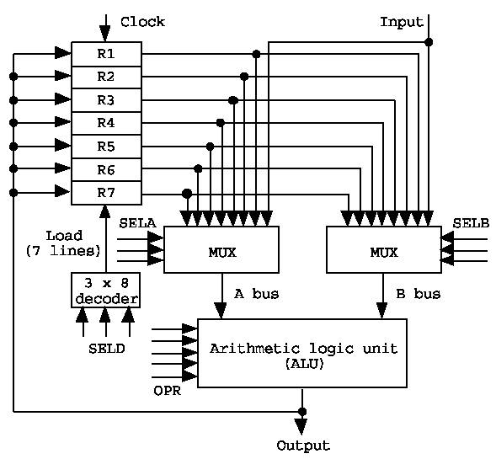
Processing Unit
Register organization

Slide 7
Processing Unit
Selection of operation
An operation is selected by the ALU operation selector (OPR).
The result of a micro-operation is directed to a destination register selected by a decoder (SELD).
Control word: The 14 binary selection inputs (3 bits for SELA, 3 for SELB, 3 for SELD, and 5 for OPR)

Slide 8

Processing Unit
Format of the control word:
Example: R1←R2+R3, (01001100100001); 00001 is for ‘+’
1) MUX A selector (SELA): to place the content of R2 into BUS A
2) MUX B selector (SELB): to place the content of R3 into BUS B
3) ALU operation selector (OPR): to provide the arithmetic addition R2 + R3
4) Decoder selector (SELD): to transfer the content of the output bus into R1

Slide 9
Processing Unit
Pipelining
Decomposing a sequential process into suboperations
Each subprocess is executed in a special dedicated segment concurrently
Example:
Multiply and Add Operation: A_{i}*B_{i}+C_{i} ( for i = 1, 2, …, 7 )
3 Suboperation Segment
1): R1 ← Ai, R2 ← Bi; Input Ai and Bi
2): R3 ← R1*R2, R4 ← Ci; Multiply and input Ci
3): R5 ← R3+R4; Add Ci

Slide 10
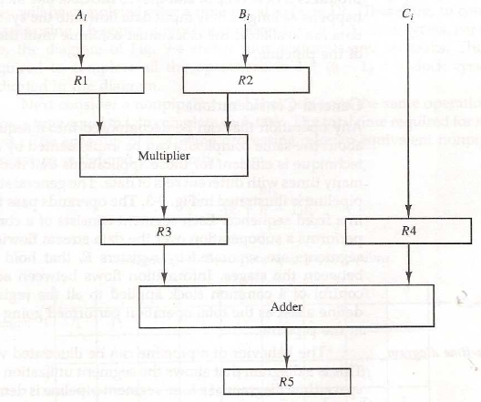
Processing Unit
Pipelining

Slide 11
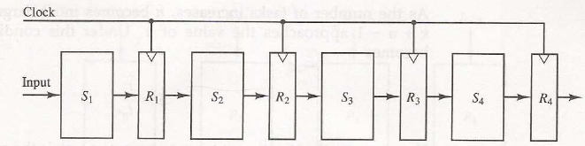
Processing Unit
General consideration of pipelining
Operation is decomposed into a number of sub operations
The technique is efficient when the same task is repeated for different data sets
The general structure of four-segment pipelining is shown in following figure:

Slide 12
Processing Unit
General consideration of pipelining
Each operation pass through all of four segments
Section Si performs the suboperation and Ri holds the temporary results
Common clock is used to transfer the data from Ri

Slide 13
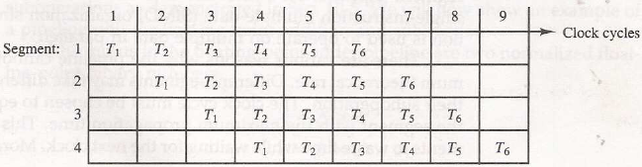
Processing Unit
Space-time representation
Pipeline can be represented as space-time diagram
Shows the segment utilization as a function of time
The space-time representation of a four-segment pipelining system:

Slide 14

Processing Unit
The diagram shows six tasks T1 through T6 executed in four segments
The speedup of pipeline system over non pipeline is defined as –
where
n : task number (6)
t_{p} : clock cycle time
t_{n} : time to complete each task in non pipeline(4t_{p})
k : segment number (4)
hence, S = n•t_{n}/( k + n - 1 )•t_{p} = 6•4t_{p}/(4+6-1)•t_{p} = 24 t_{p} / 9 t_{p} = 2.67
If n → ∝; S=t_{n}/t_{p}
So, Nonpipline (t_{n})=Pipeline (k.t_{p}) ➔ S=k.t_{p}/t_{p}=k

Slide 15
Processing Unit
Instruction Pipeline
The computer needs to process each instruction with the following sequence of steps:
1) Fetch the instruction from memory
2) Decode the instruction
3) Calculate the effective address
4) Fetch the operands from memory
5) Execute the instruction
6) Store the result in the proper place

Slide 16
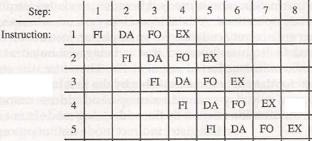
Processing Unit
Example: Four-segment Instruction Pipeline
The above six steps can be performed with the following Four-segment CPU pipeline:
1) FI: Instruction Fetch
2) DA: Decode Instruction & calculate EA
3) FO: Operand Fetch
4) EX: Execution

